Slide 1
WIT Website Redesign Competition
By:
Norah Jean-Charles

Slide 2
A NEW FEEL
My design incorporates a new feel by reducing the redundancy of the website/ navigations and making the look consistent and modern
To reduce redundancy, pages such as JOIN WIT (aka my account), SUPPORT(aka donate and volunteer) and WIT EVENTS (aka calendar and all the WIT programs) have been excluded
Global navigation features for ease of use are:
Navigation header on every page
Dropdowns include Participation and Global Call to Action
Footer on every page

Slide 3
The Header
-friendly user interface:
Logo takes you to the home page no matter what page you are on
Tabs are clearly labeled and displayed
Tabs have drop downs to categorize items and reduce clutter/ overwhelming info in the header
Invert color when hovering
Invert color when clicked on and directed to page to let user know what tab is active/ what page they are on
Global

Slide 4
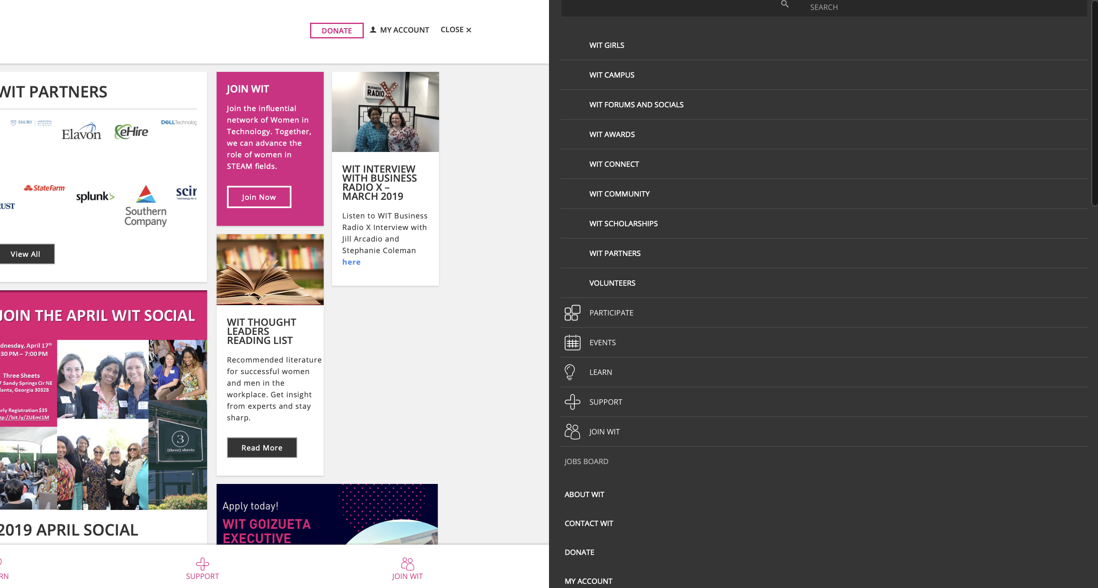
Menu Original

Slide 5

Header
Desktop Version

Slide 6

Header - Tabs (Global Call To Action)

Slide 7
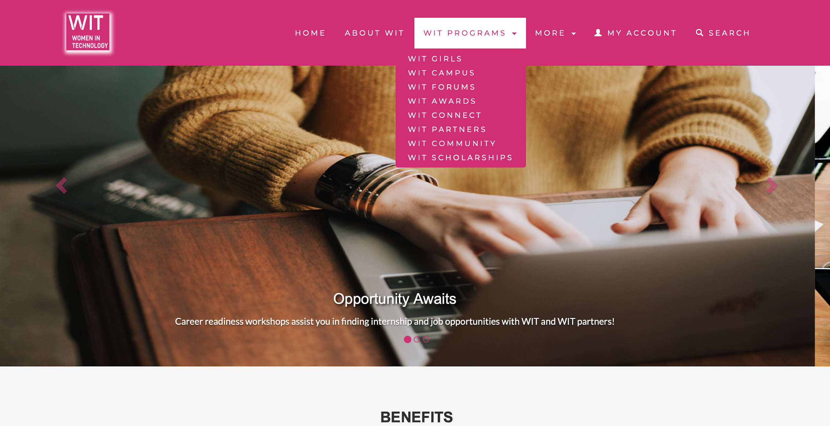
Header - Tabs (Participation)

Slide 8


Header
Mobile
Version

Slide 9
The Footer
-friendly user interface:
Highlights field, on click, that user is typing in
Highlights social media icon on hover
Global
About WIT
Subscribe
Social Media links
Contact

Slide 10
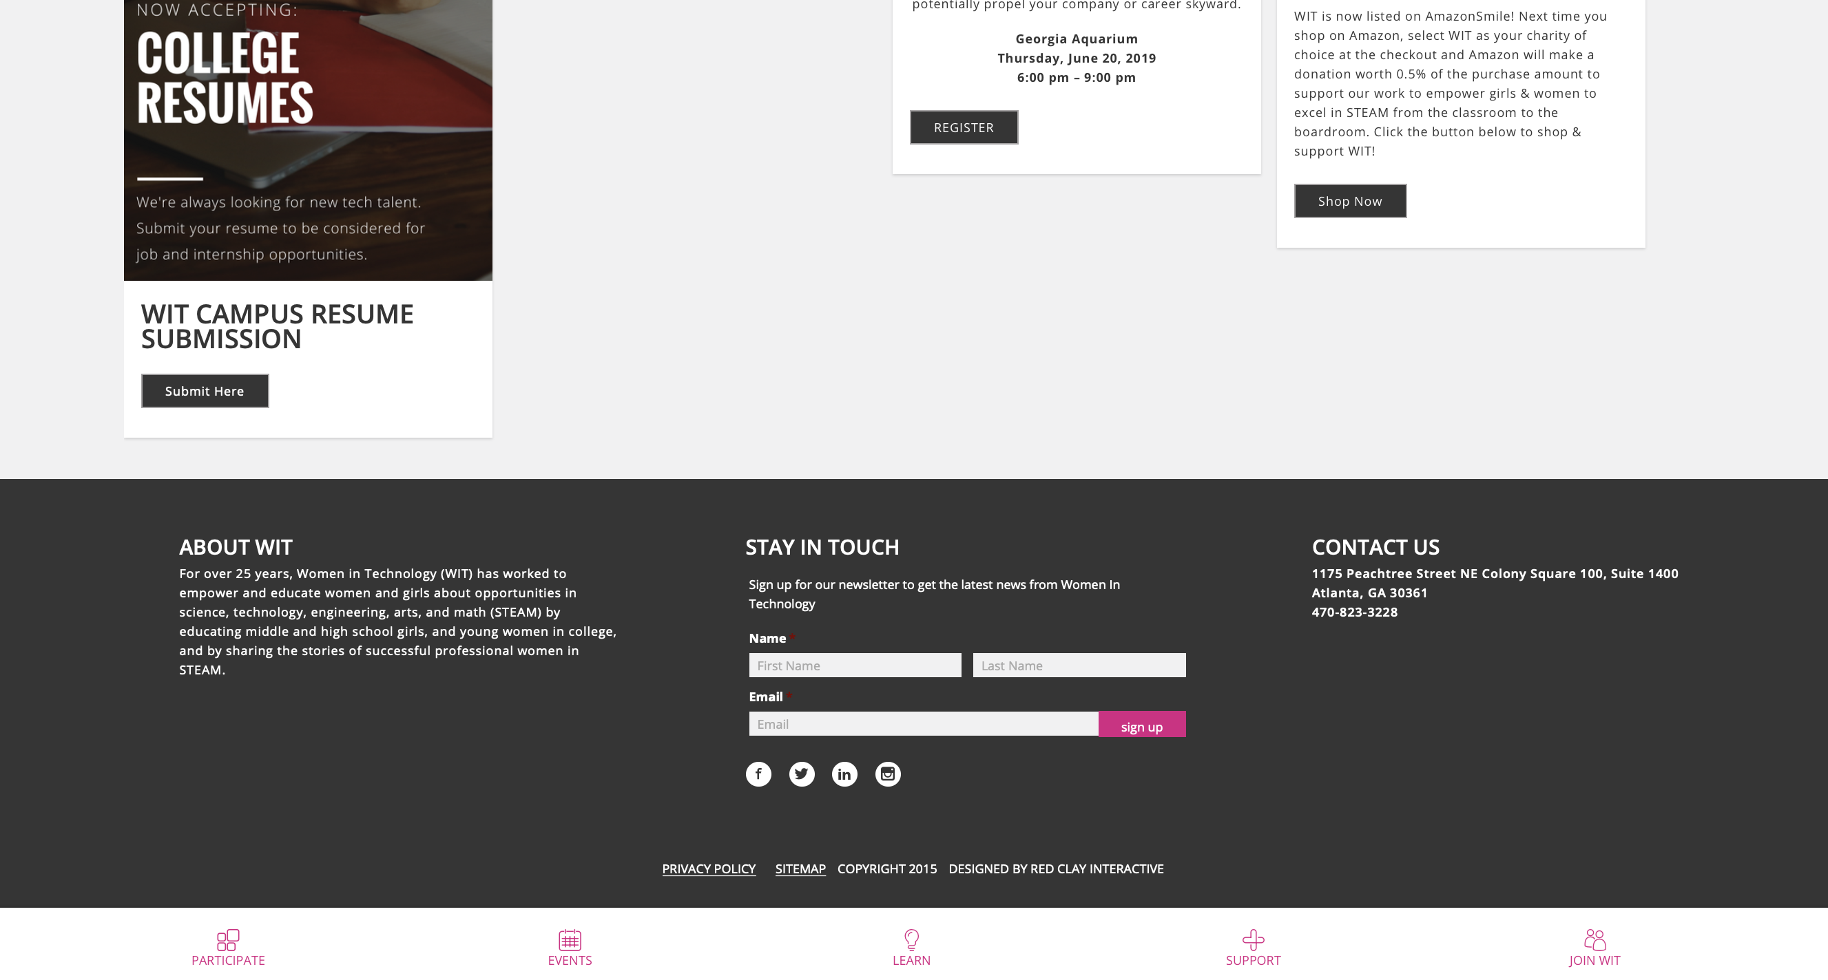
Footer Original

Slide 11
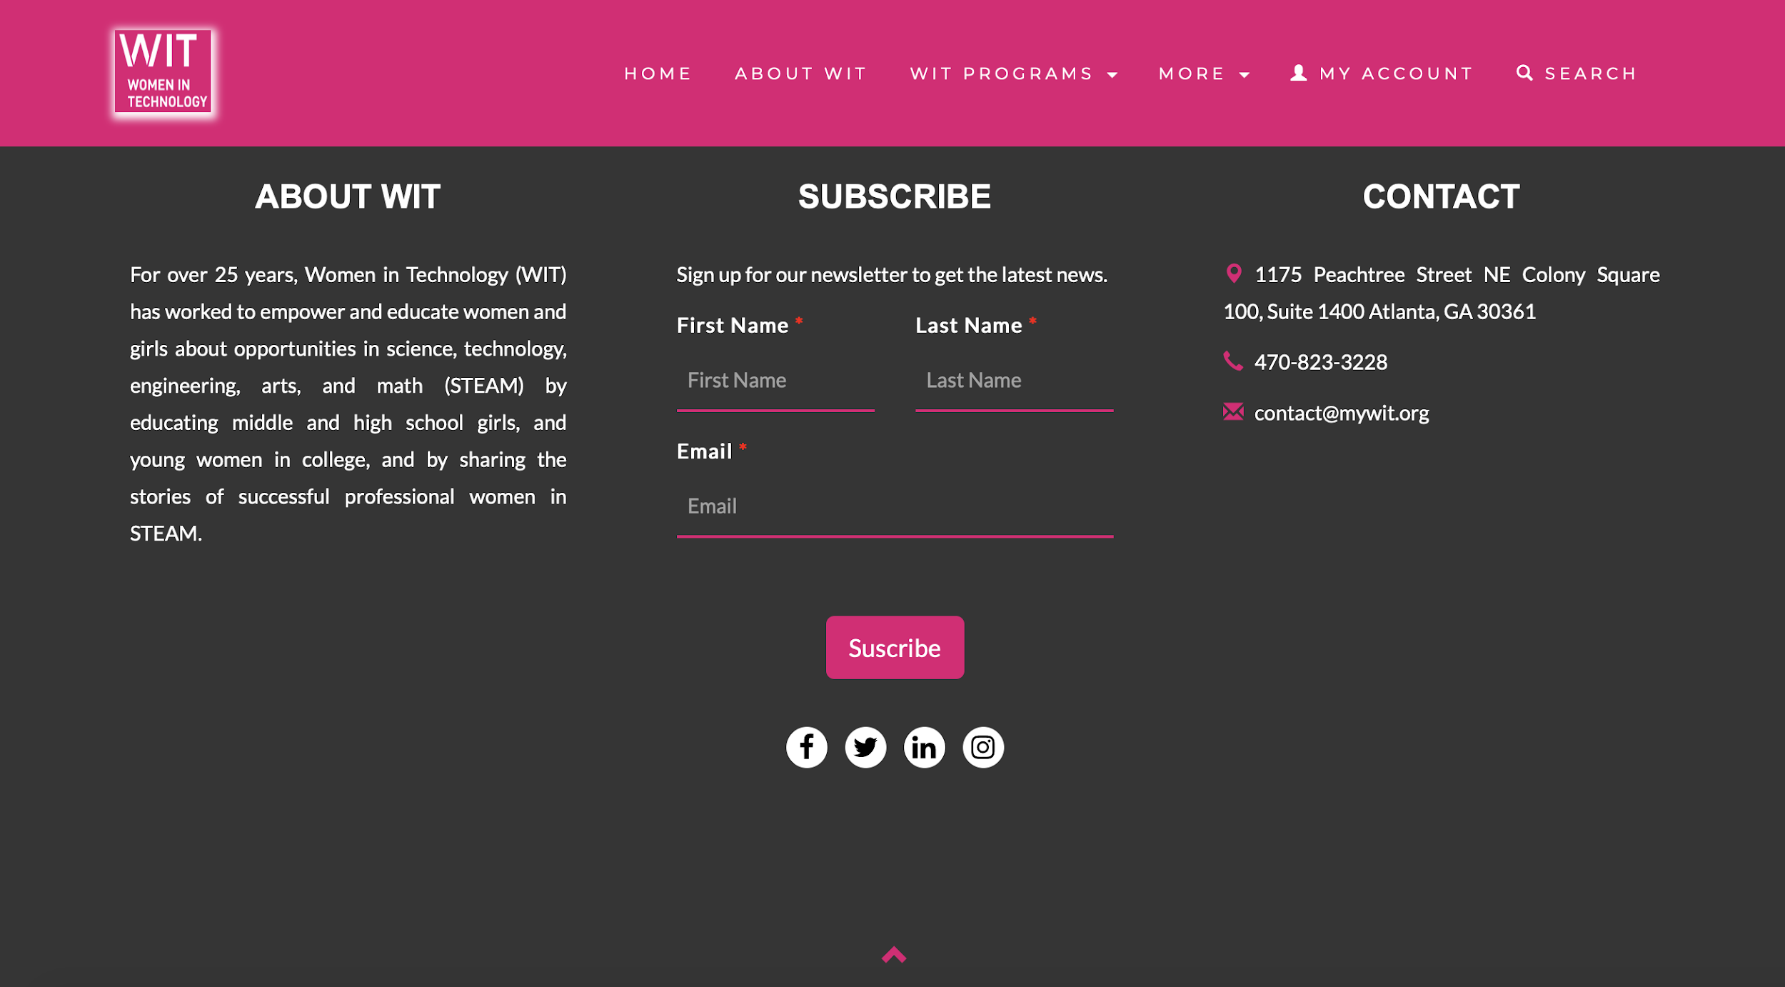
Footer
Desktop Version

Slide 12
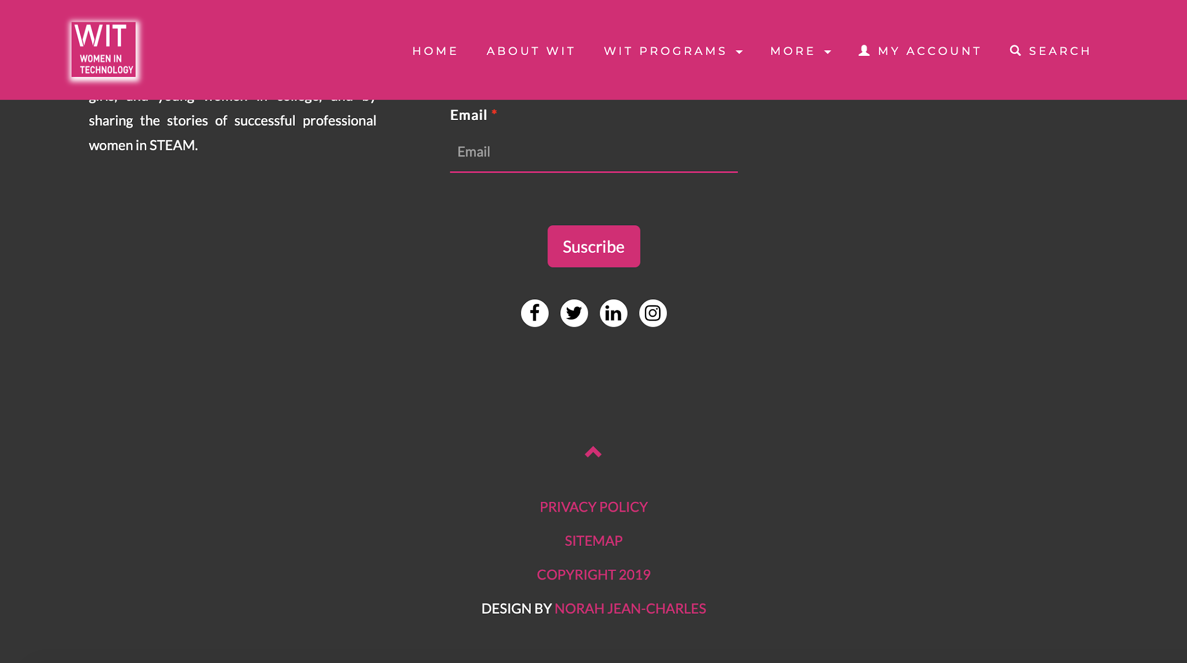
Footer
Desktop Version

Slide 13
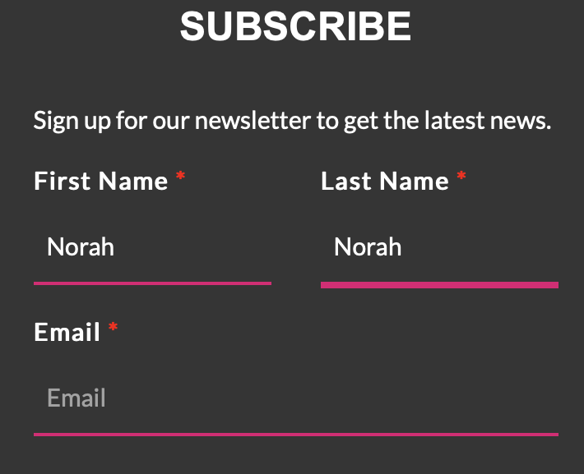

Footer - Highlights on Fields and Icons

Slide 14
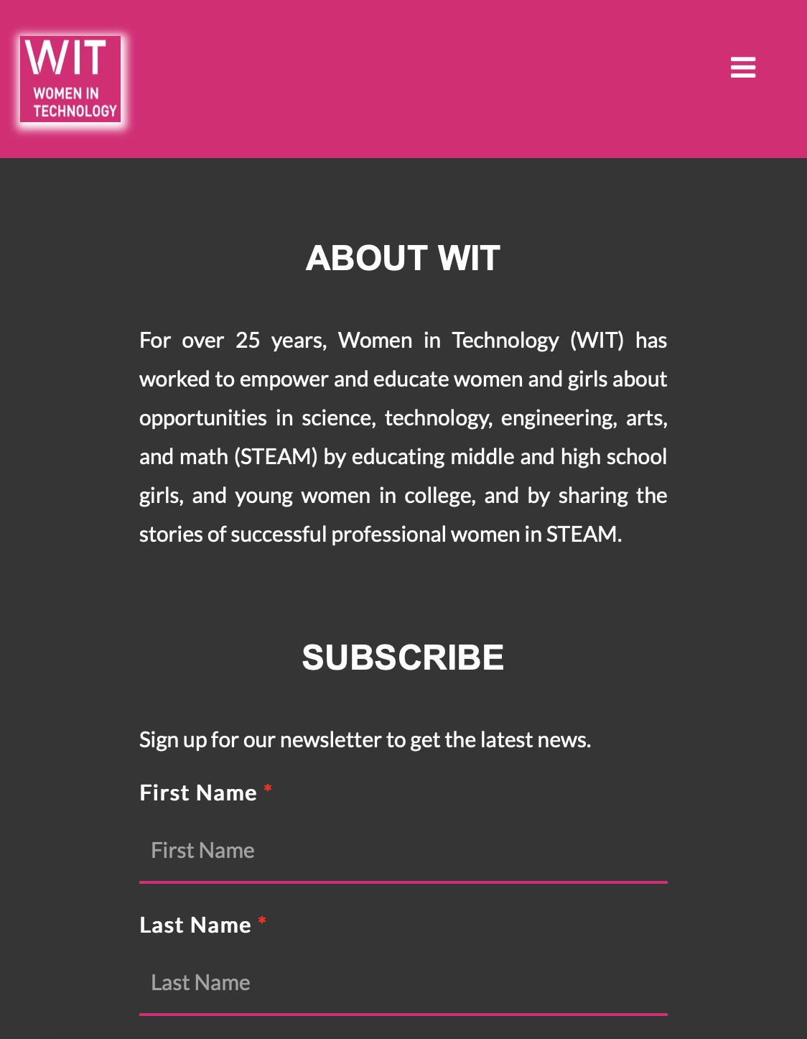
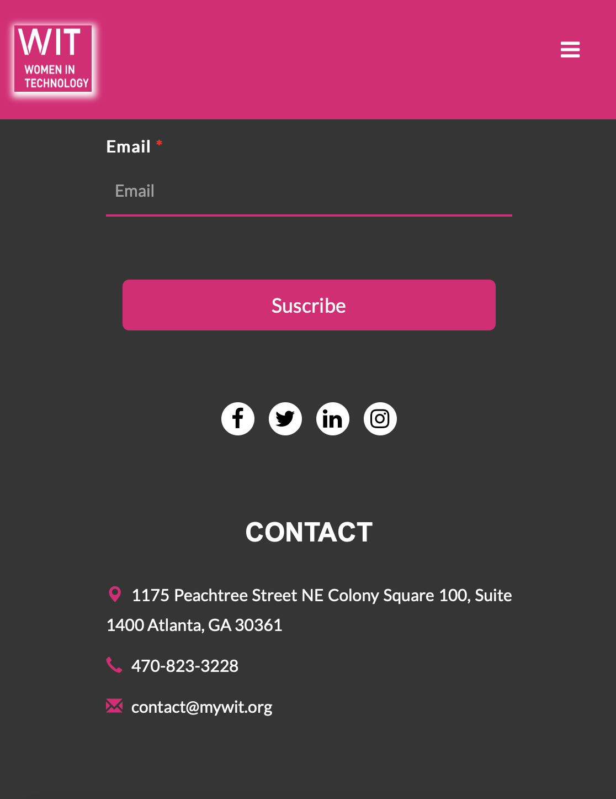
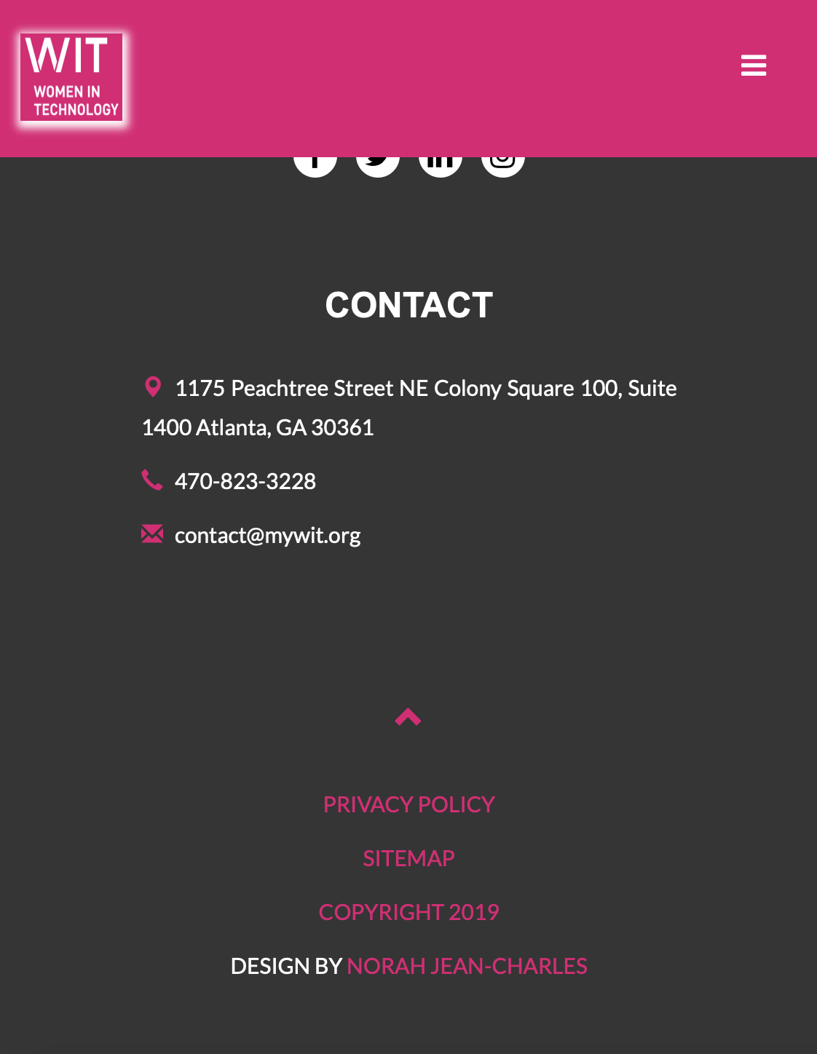
Footer - Mobile Version

Slide 15
The HomePage
-friendly user interface:
Light shadow on hover to determine/highlight which article you are reading
Invert button consistent with invert navigation header
Twitter Feed

Slide 16
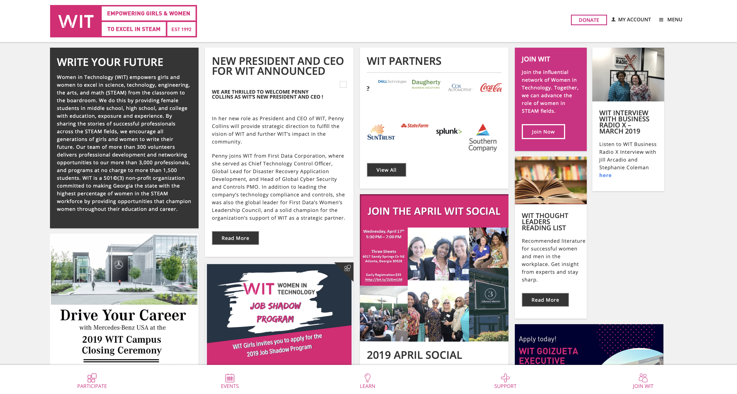
Homepage Original

Slide 17
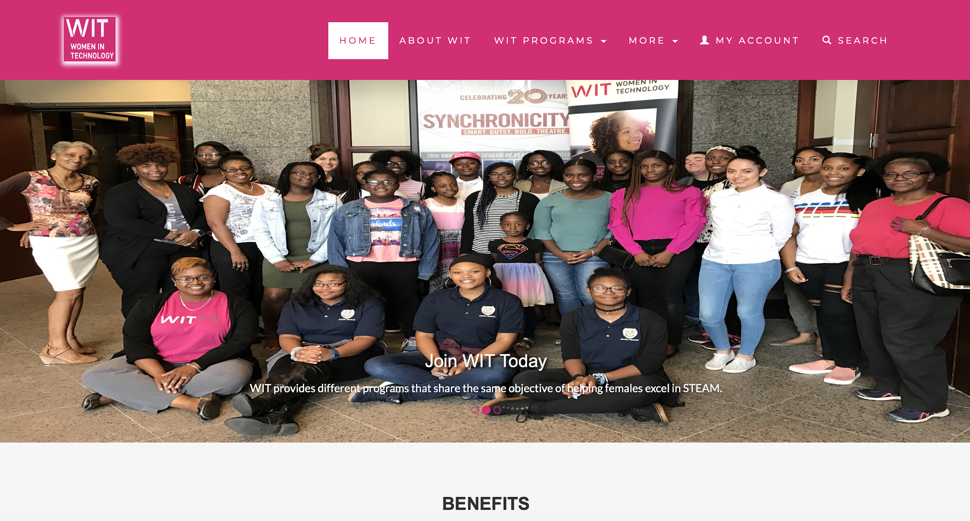
Homepage
Desktop
Version

Slide 18

Homepage
Desktop
Version

Slide 19
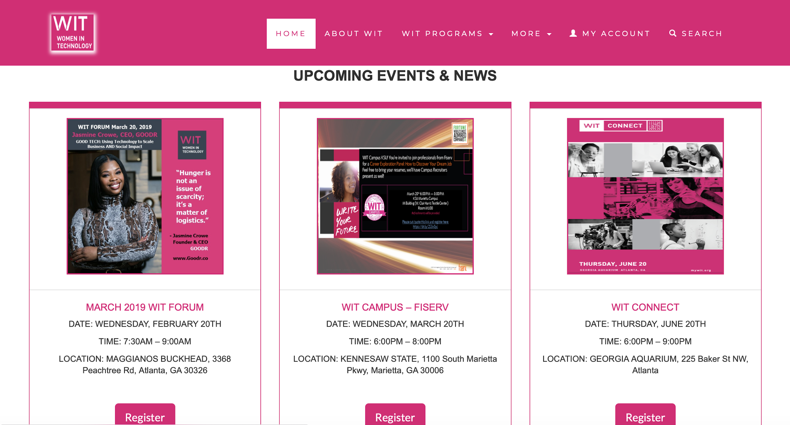
Homepage
Desktop
Version

Slide 20
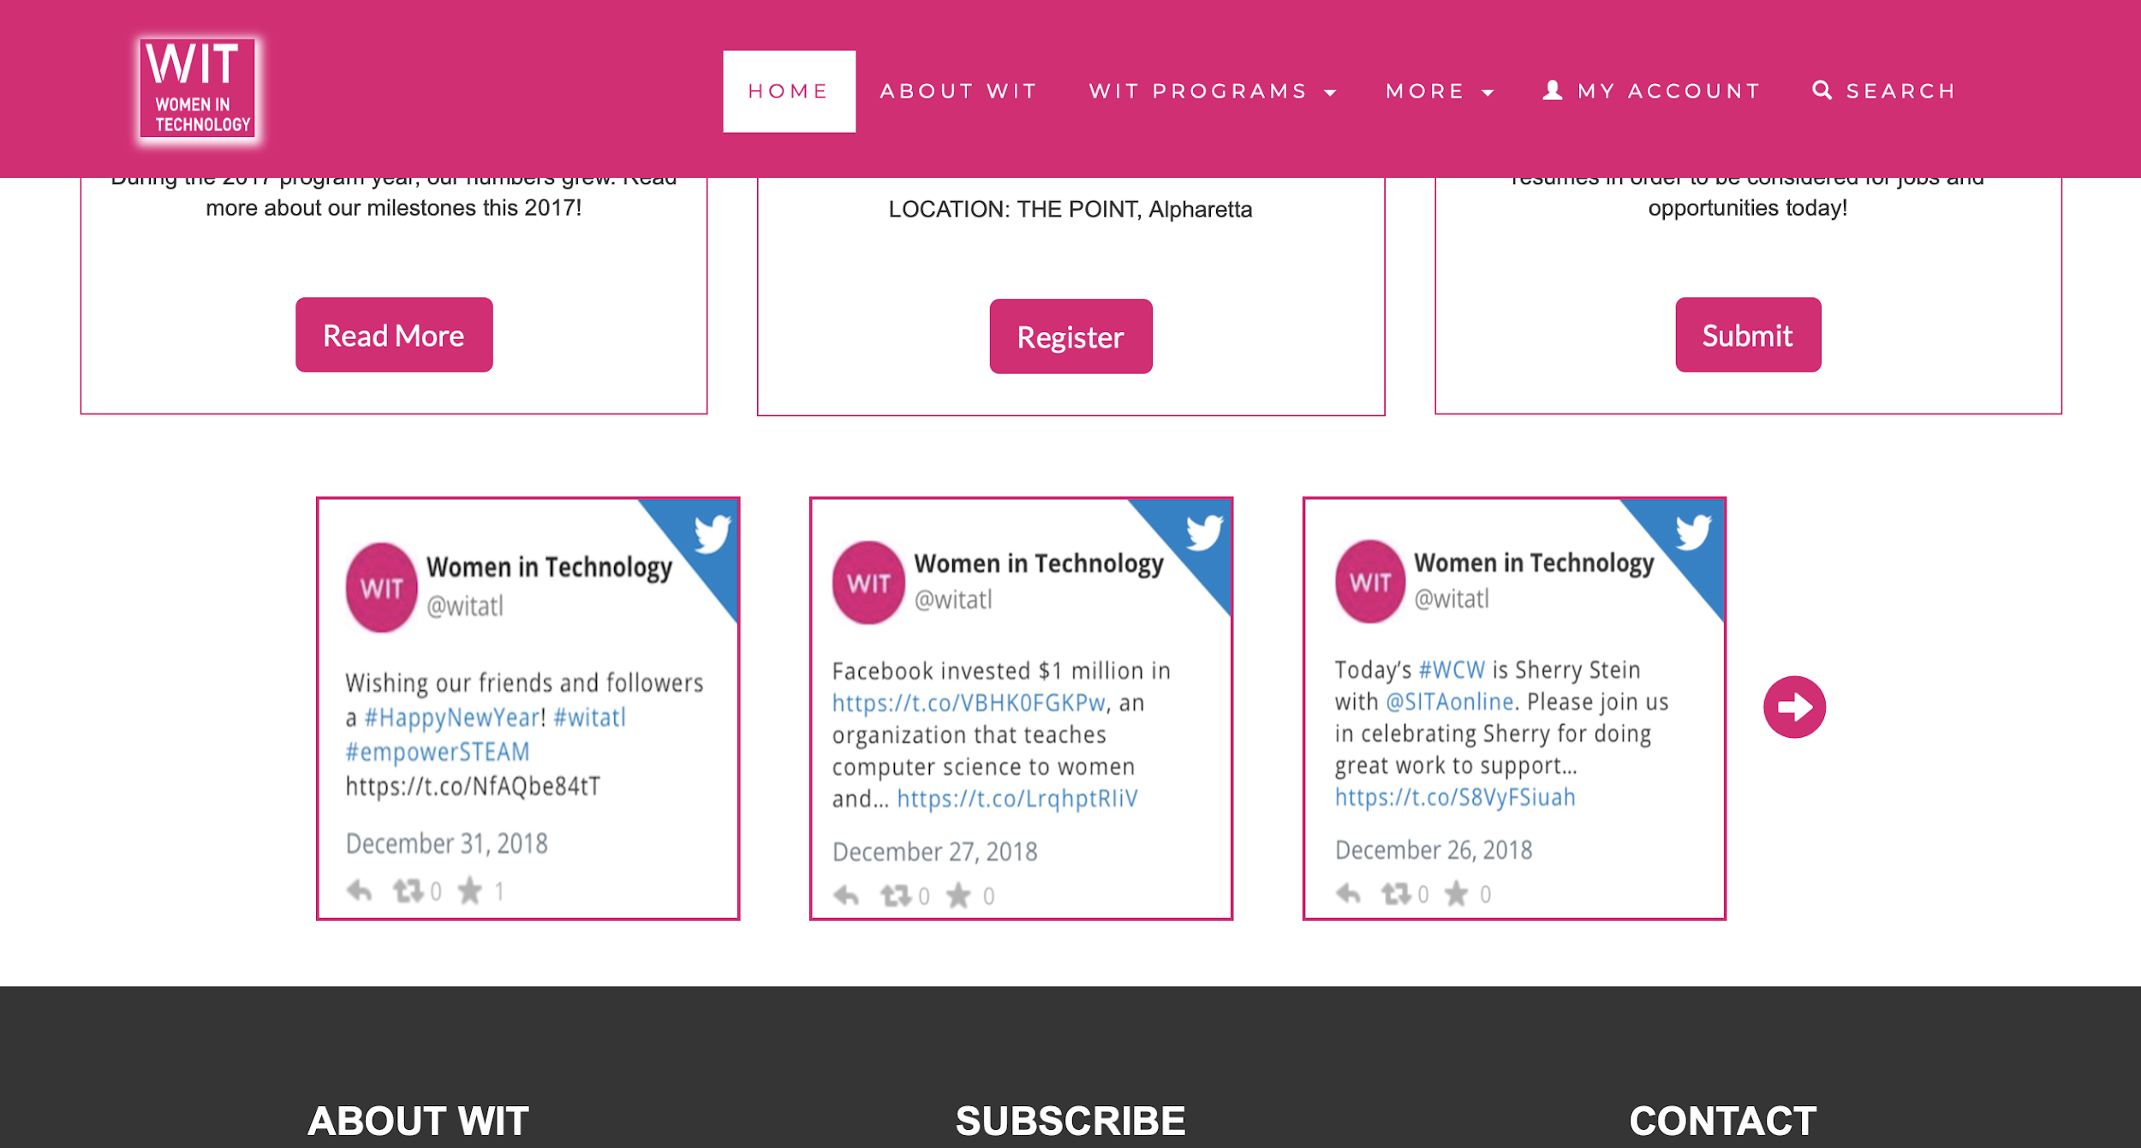
Homepage
Desktop
Version

Slide 21
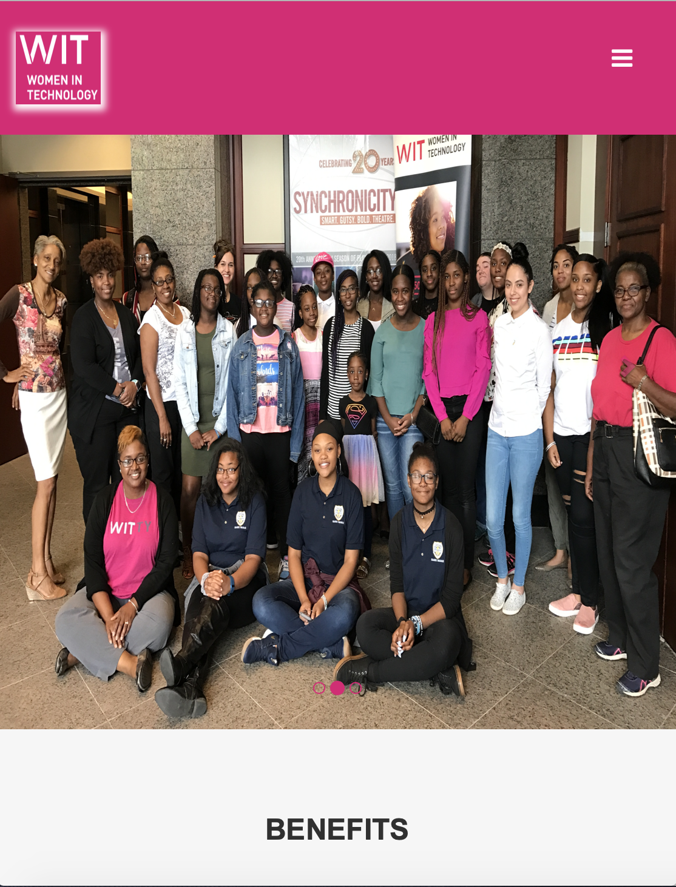

Homepage
Mobile
Version

Slide 22

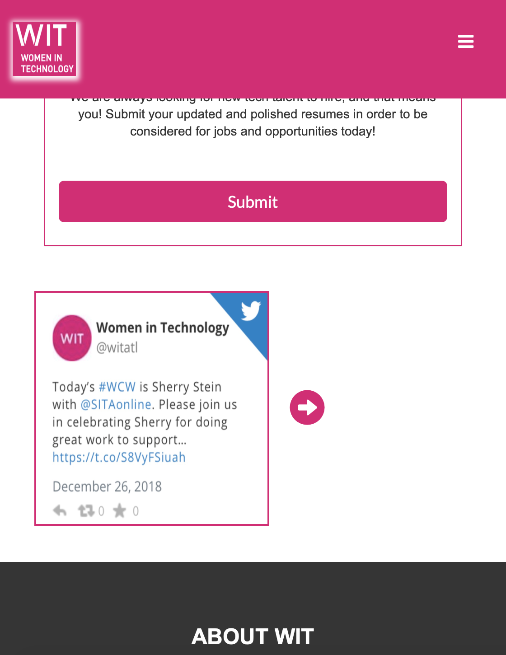
Homepage
Mobile
Version

Slide 23
The About Page
-friendly user interface:
Light shadow on hover to determine/highlight which box you are reading
Names of members made to be clicked on (in case you’d want to add a bio)

Slide 24
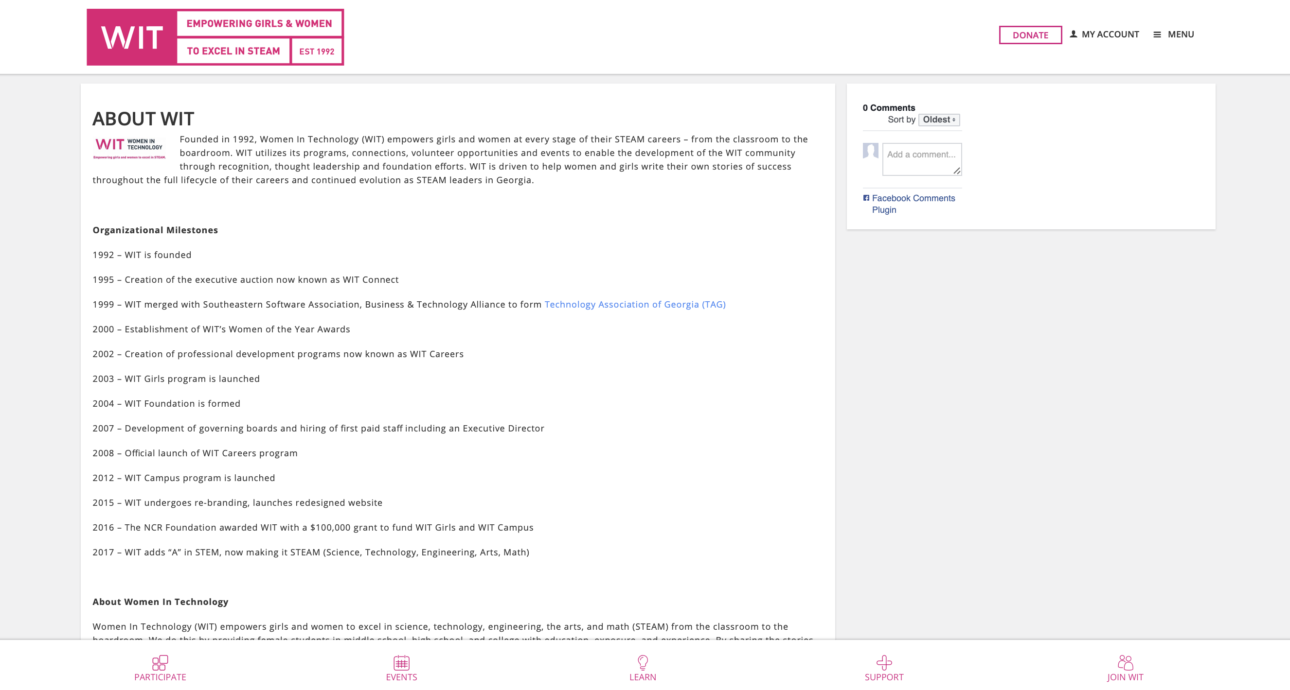
About Original

Slide 25
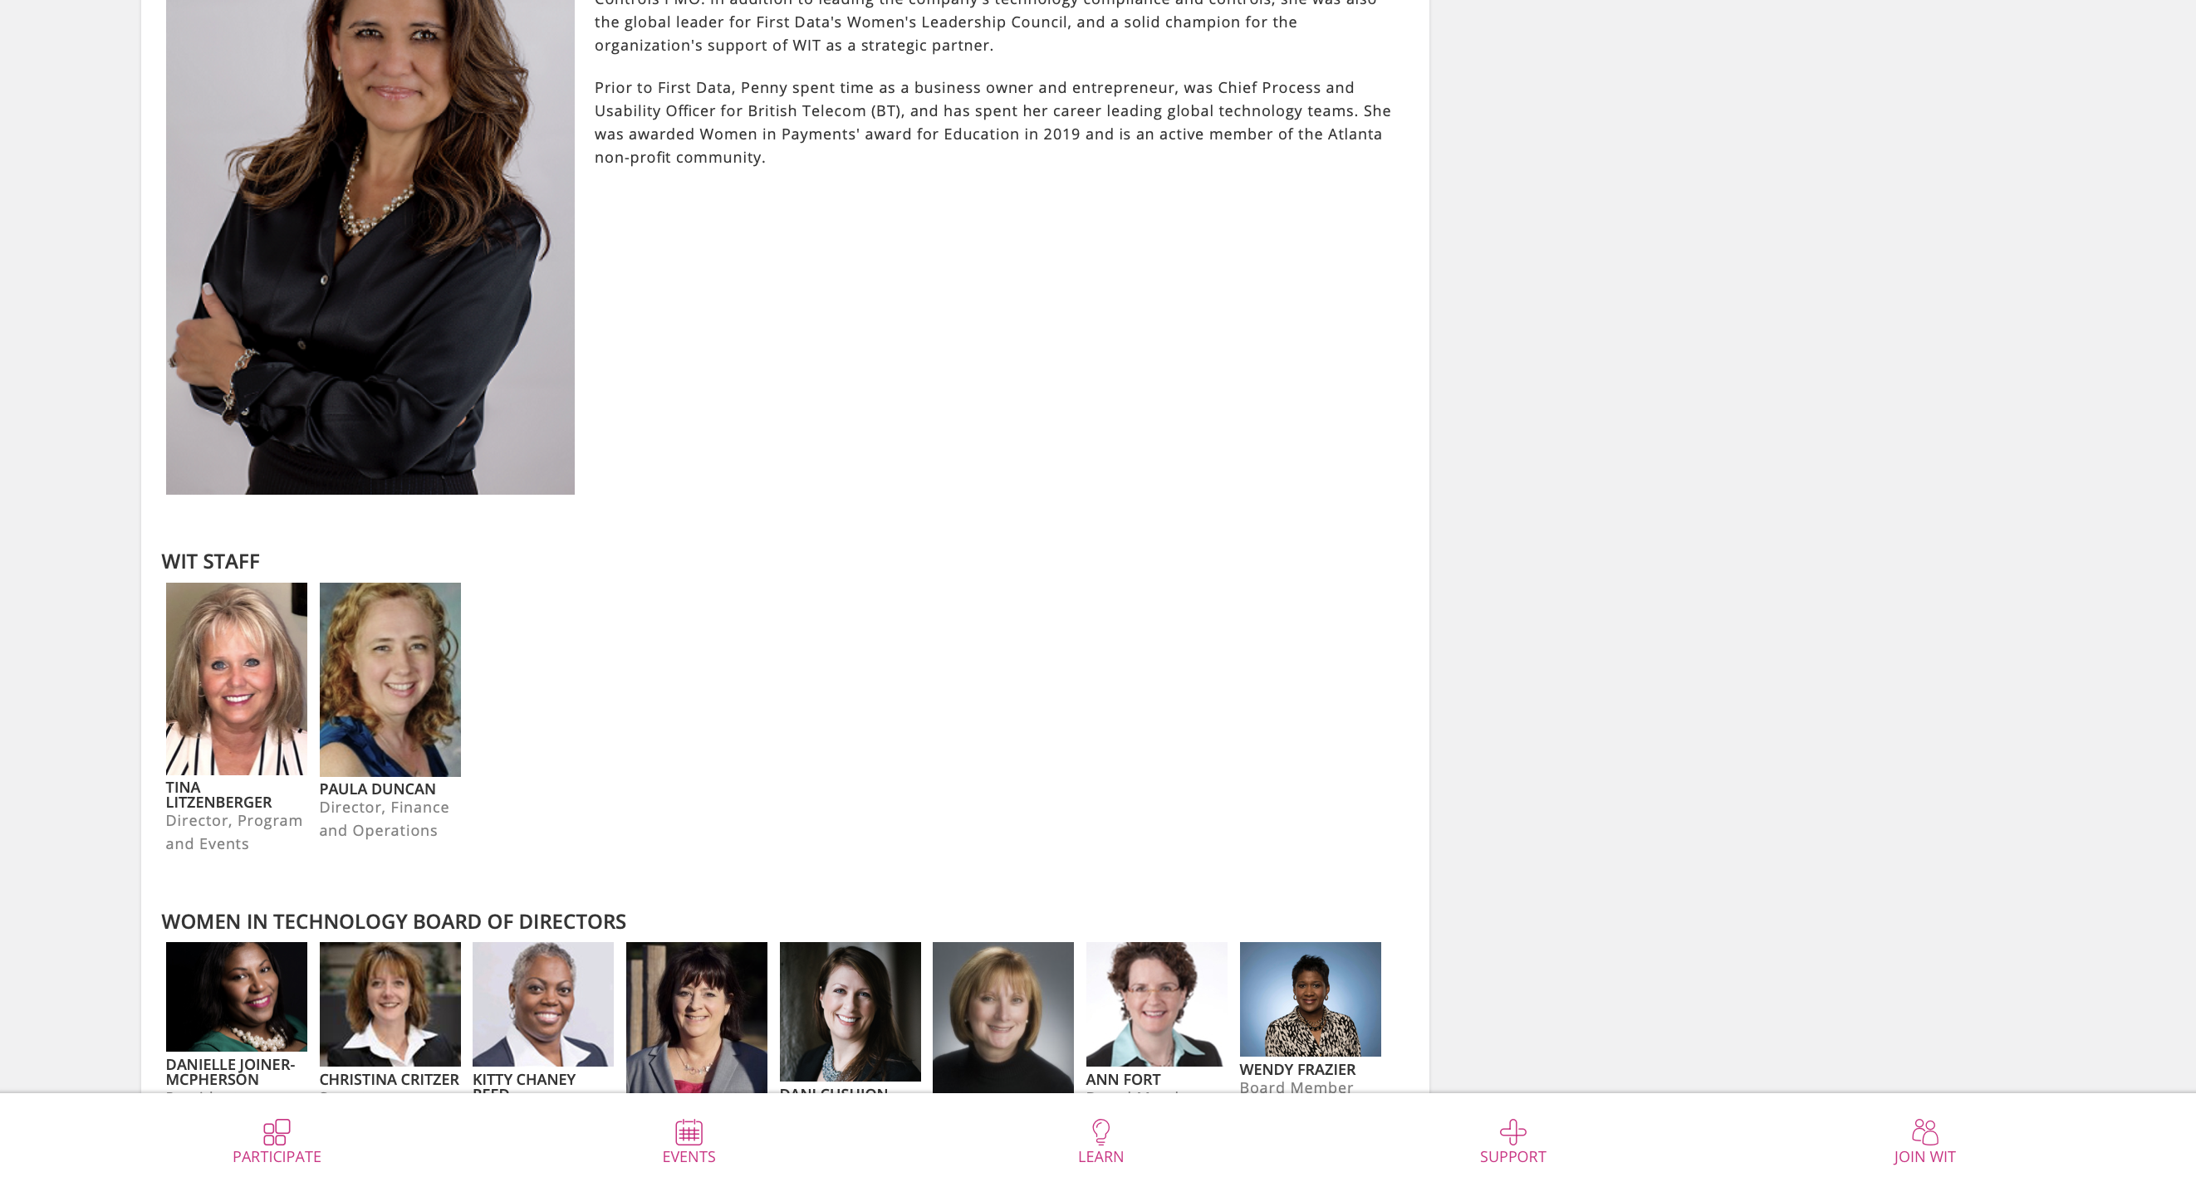
About Original

Slide 26

About WIT
Desktop
Version

Slide 27
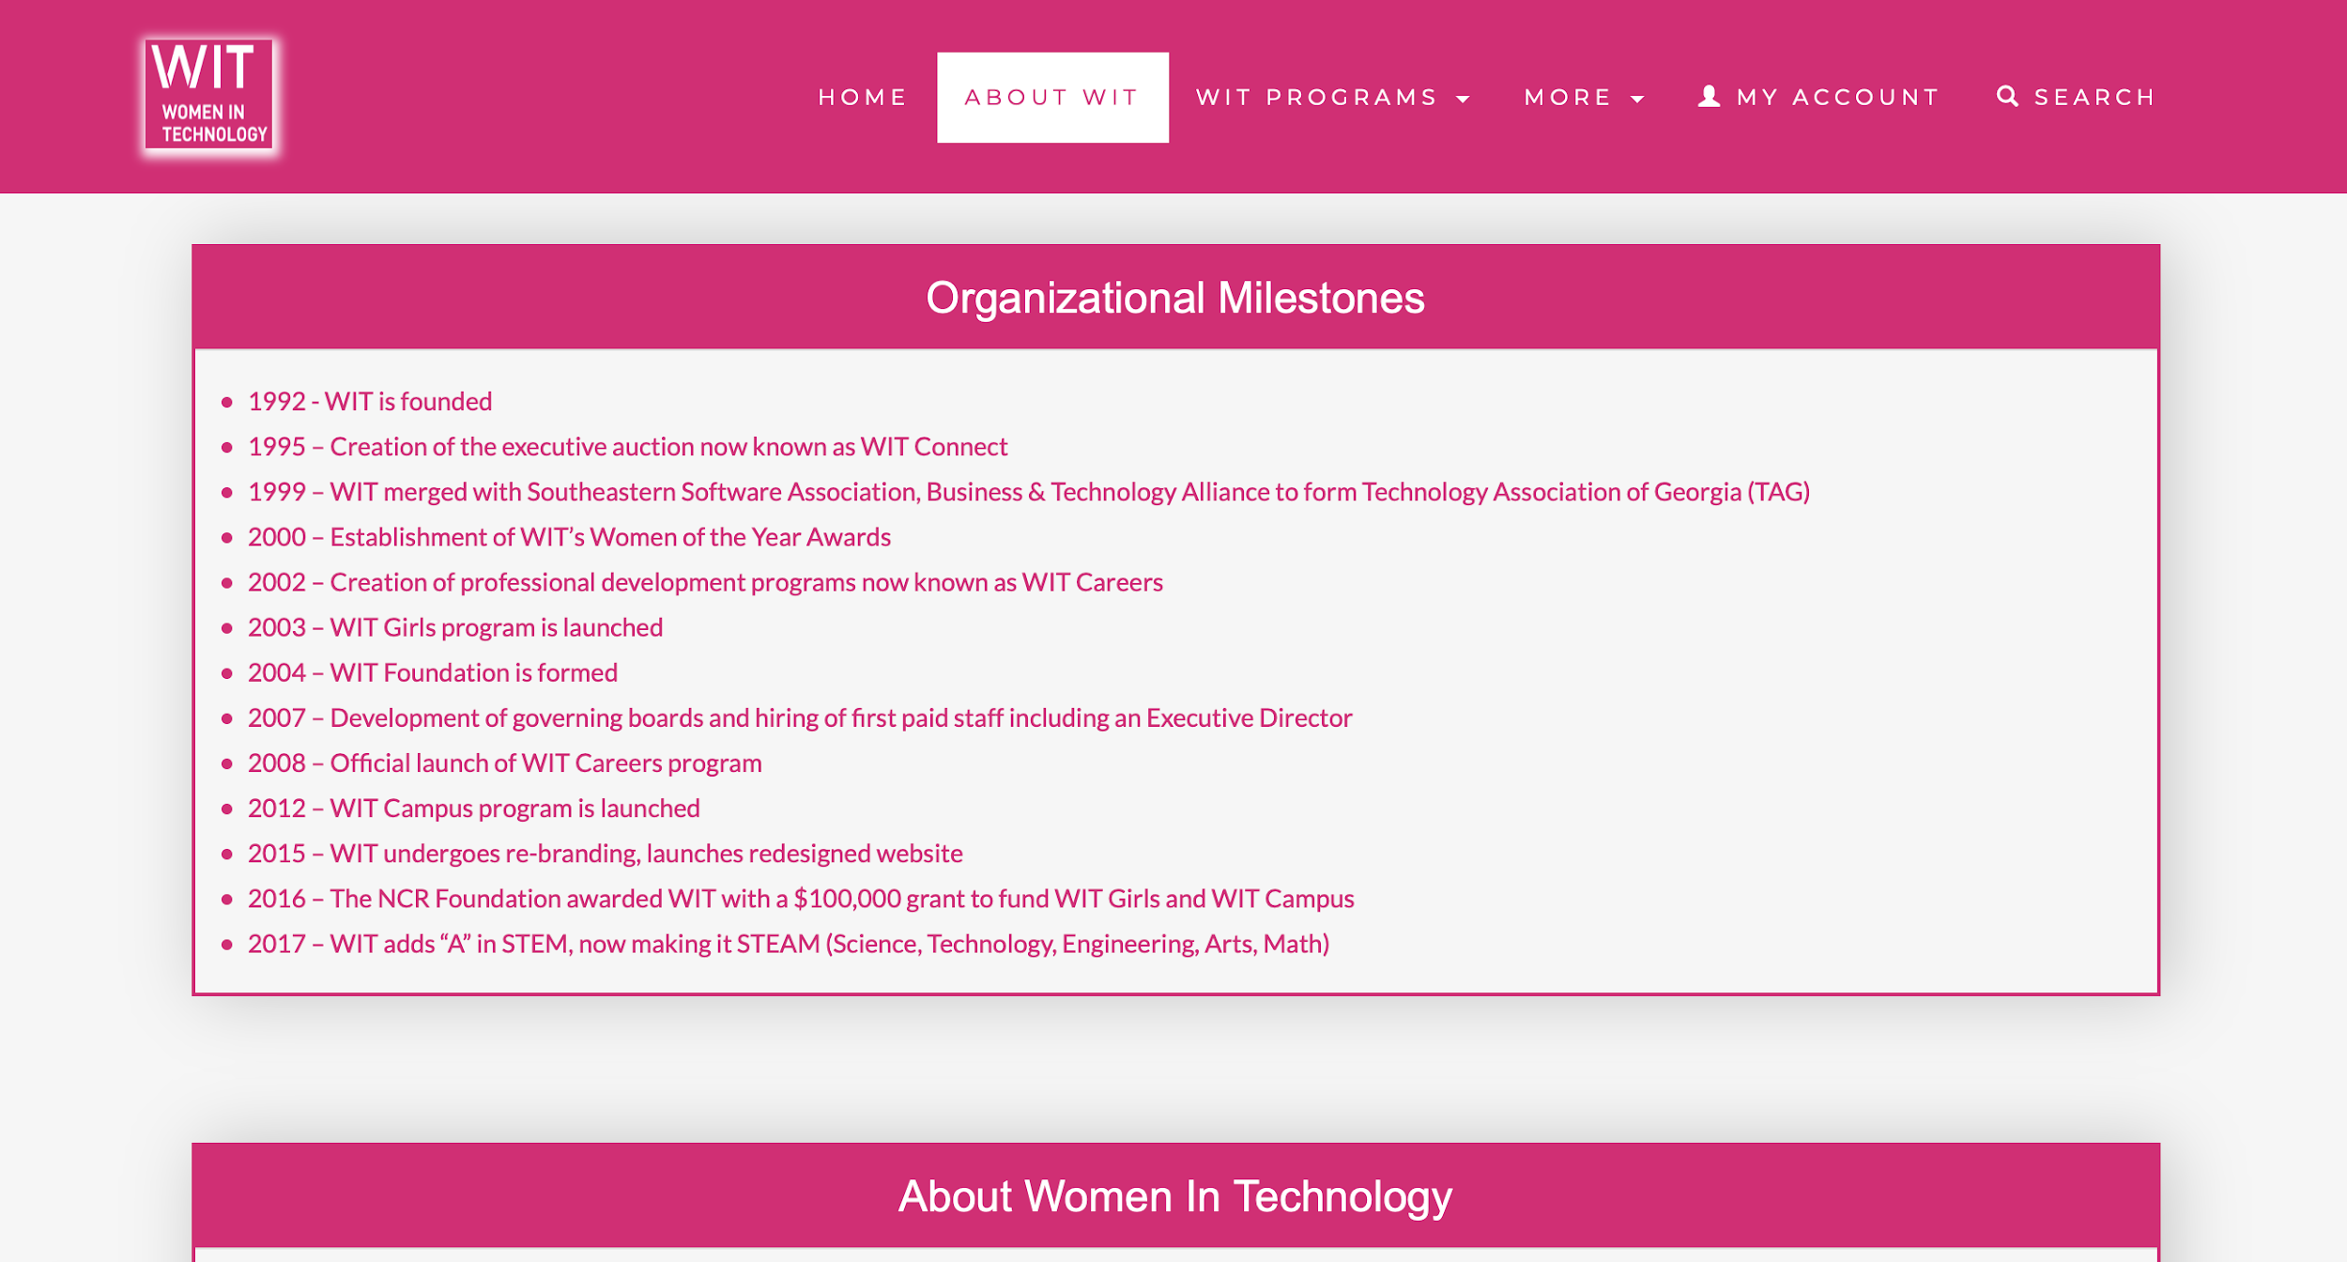
About WIT
Desktop
Version

Slide 28

About WIT
Desktop
Version

Slide 29

About WIT
Desktop
Version

Slide 30

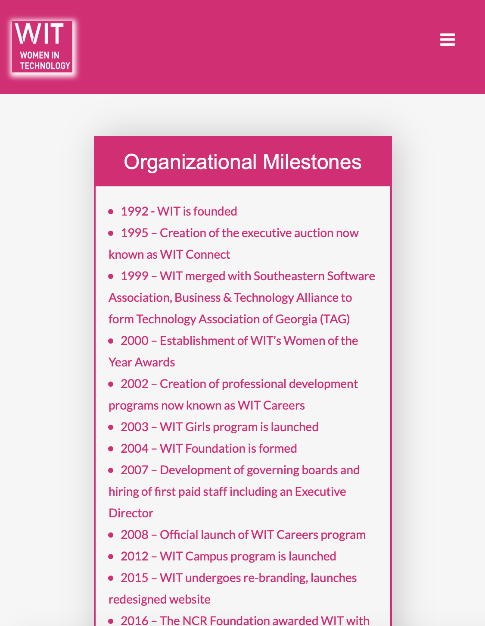
About WIT
Mobile
Version

Slide 31

About WIT
Mobile
Version

Slide 32
WIT Program Pages

Slide 33
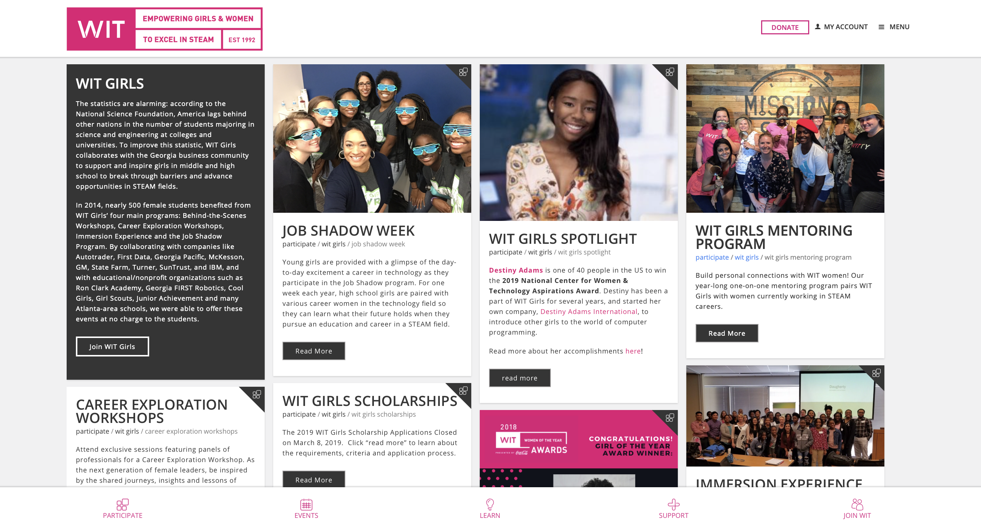
General LayOut Original

Slide 34

WIT GENERAL LAYOUT

Slide 35
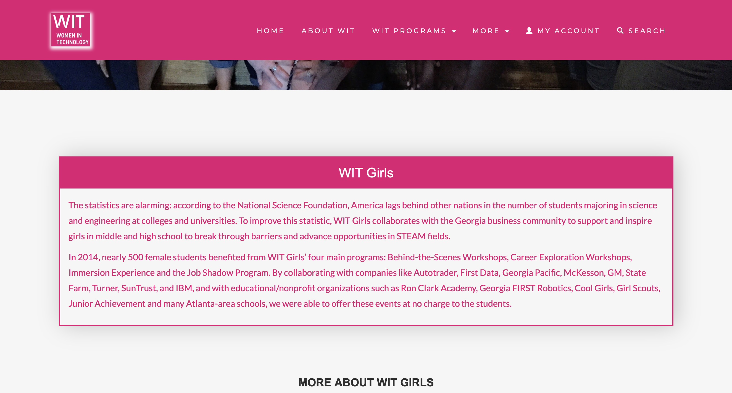
WIT GENERAL LAYOUT

Slide 36

WIT GENERAL LAYOUT

Slide 37
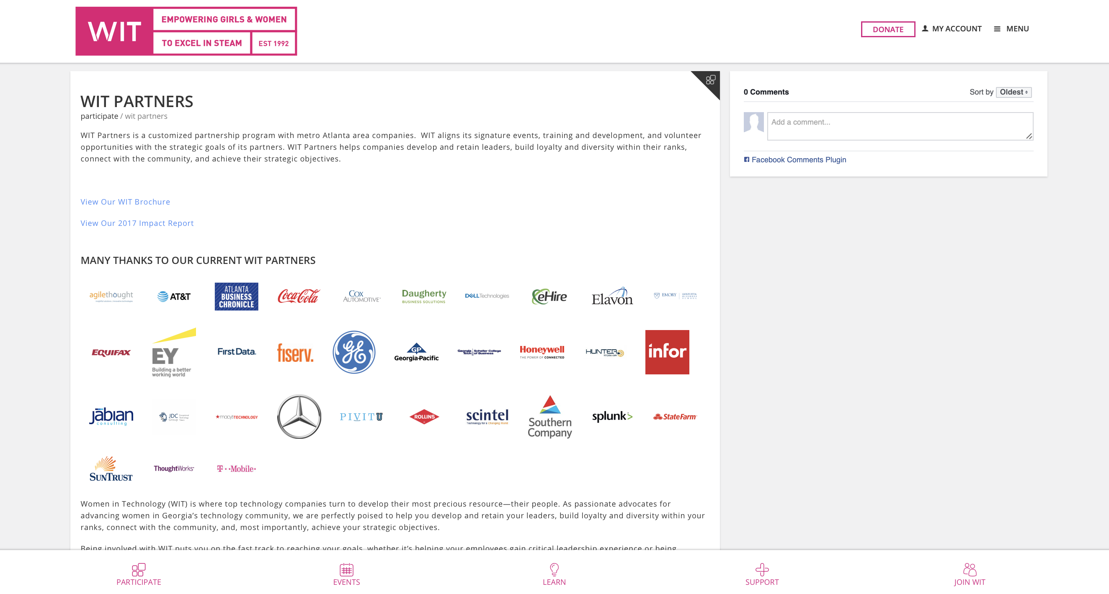
Partners Original

Slide 38
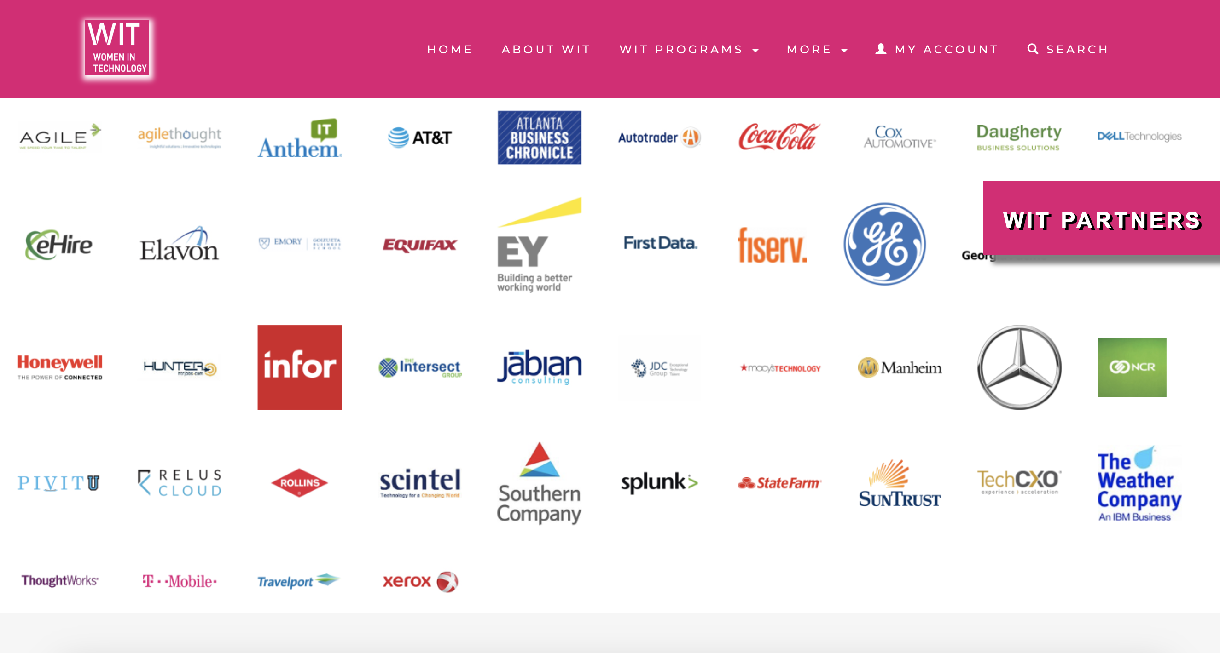
WIT PARTNERS

Slide 39
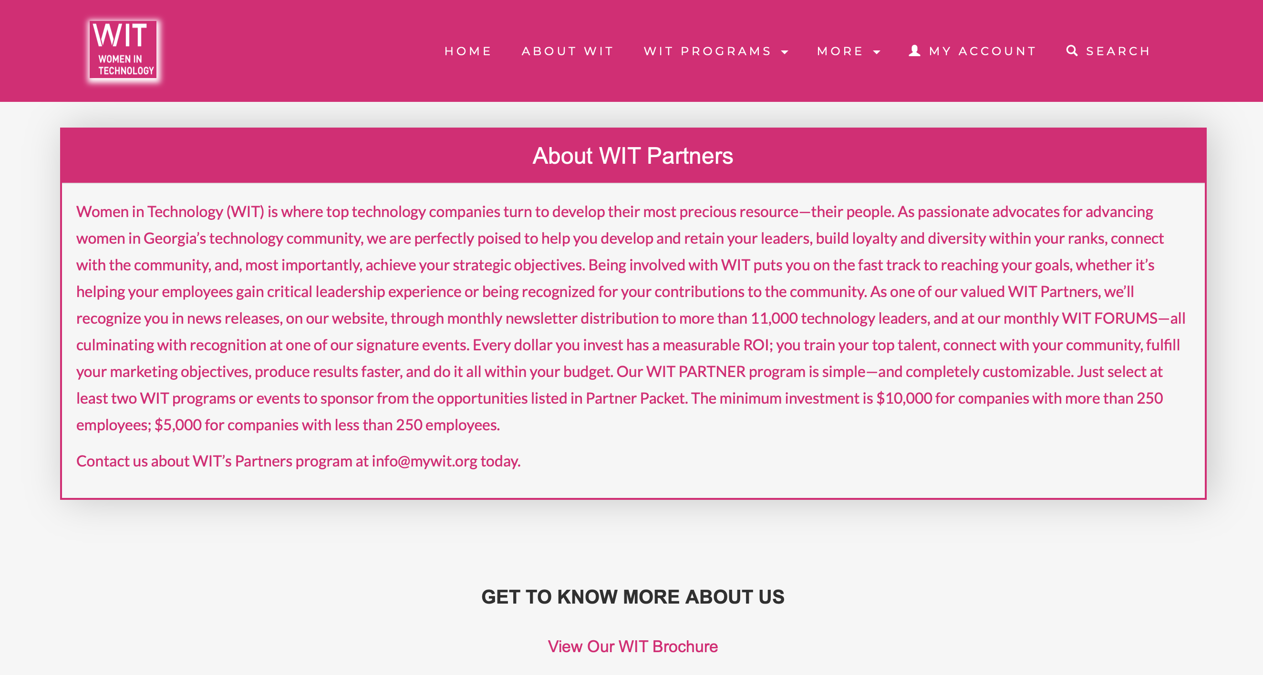
WIT PARTNERS

Slide 40
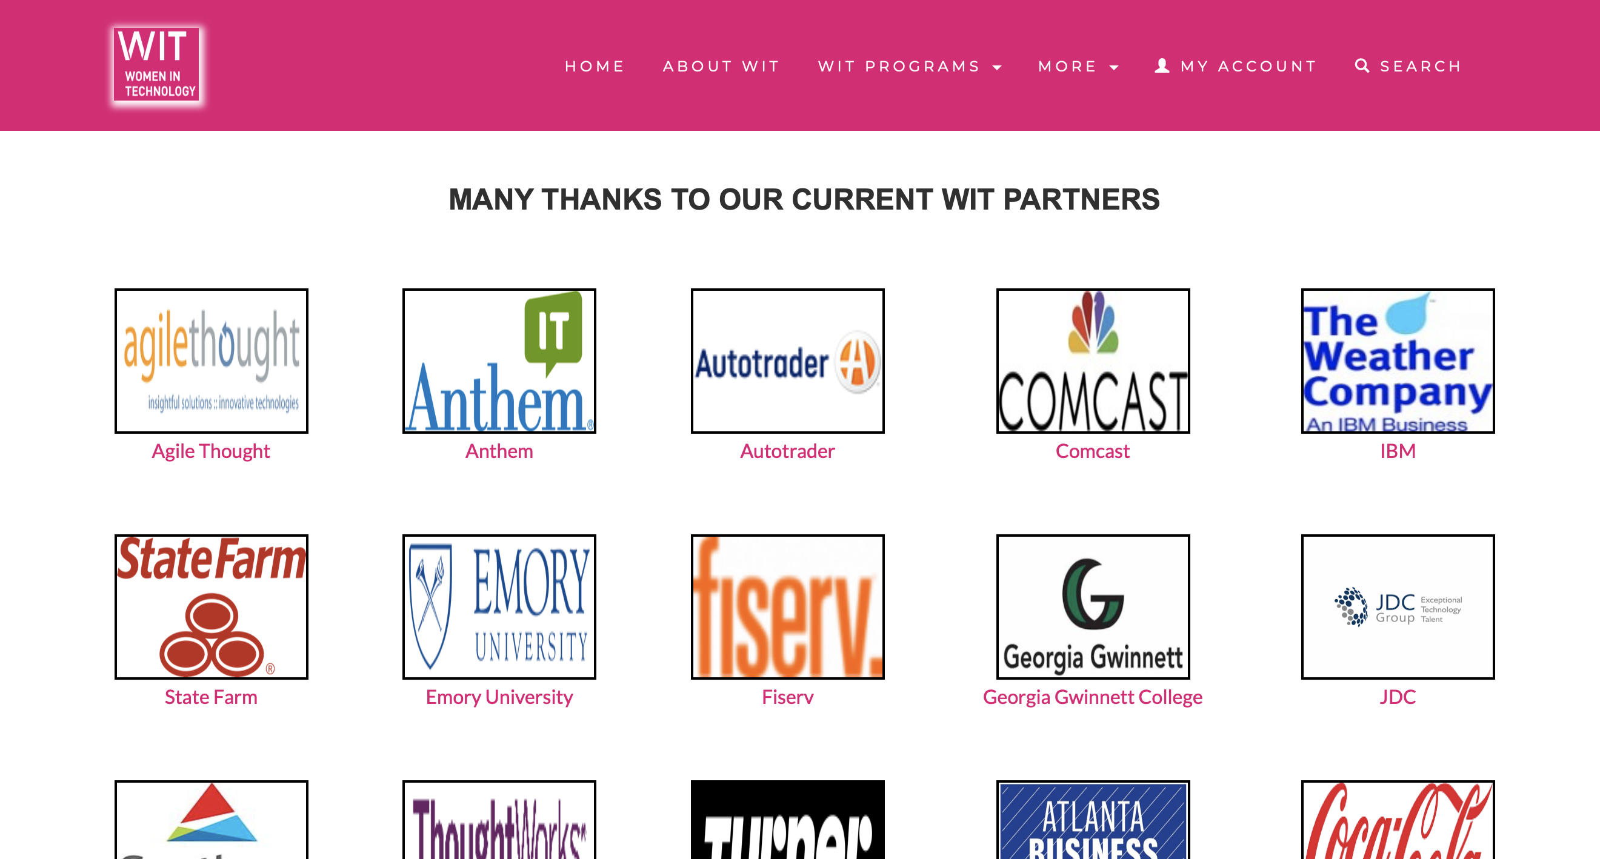
WIT PARTNERS

Slide 41
More Pages

Slide 42
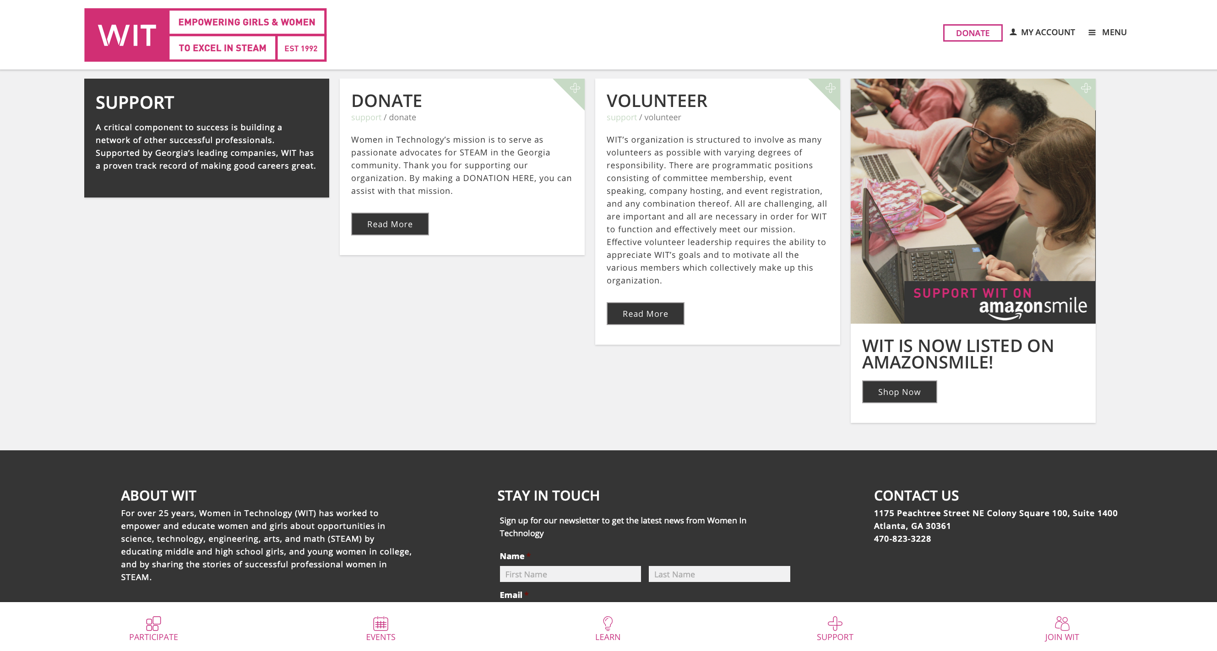
Donate Original

Slide 43
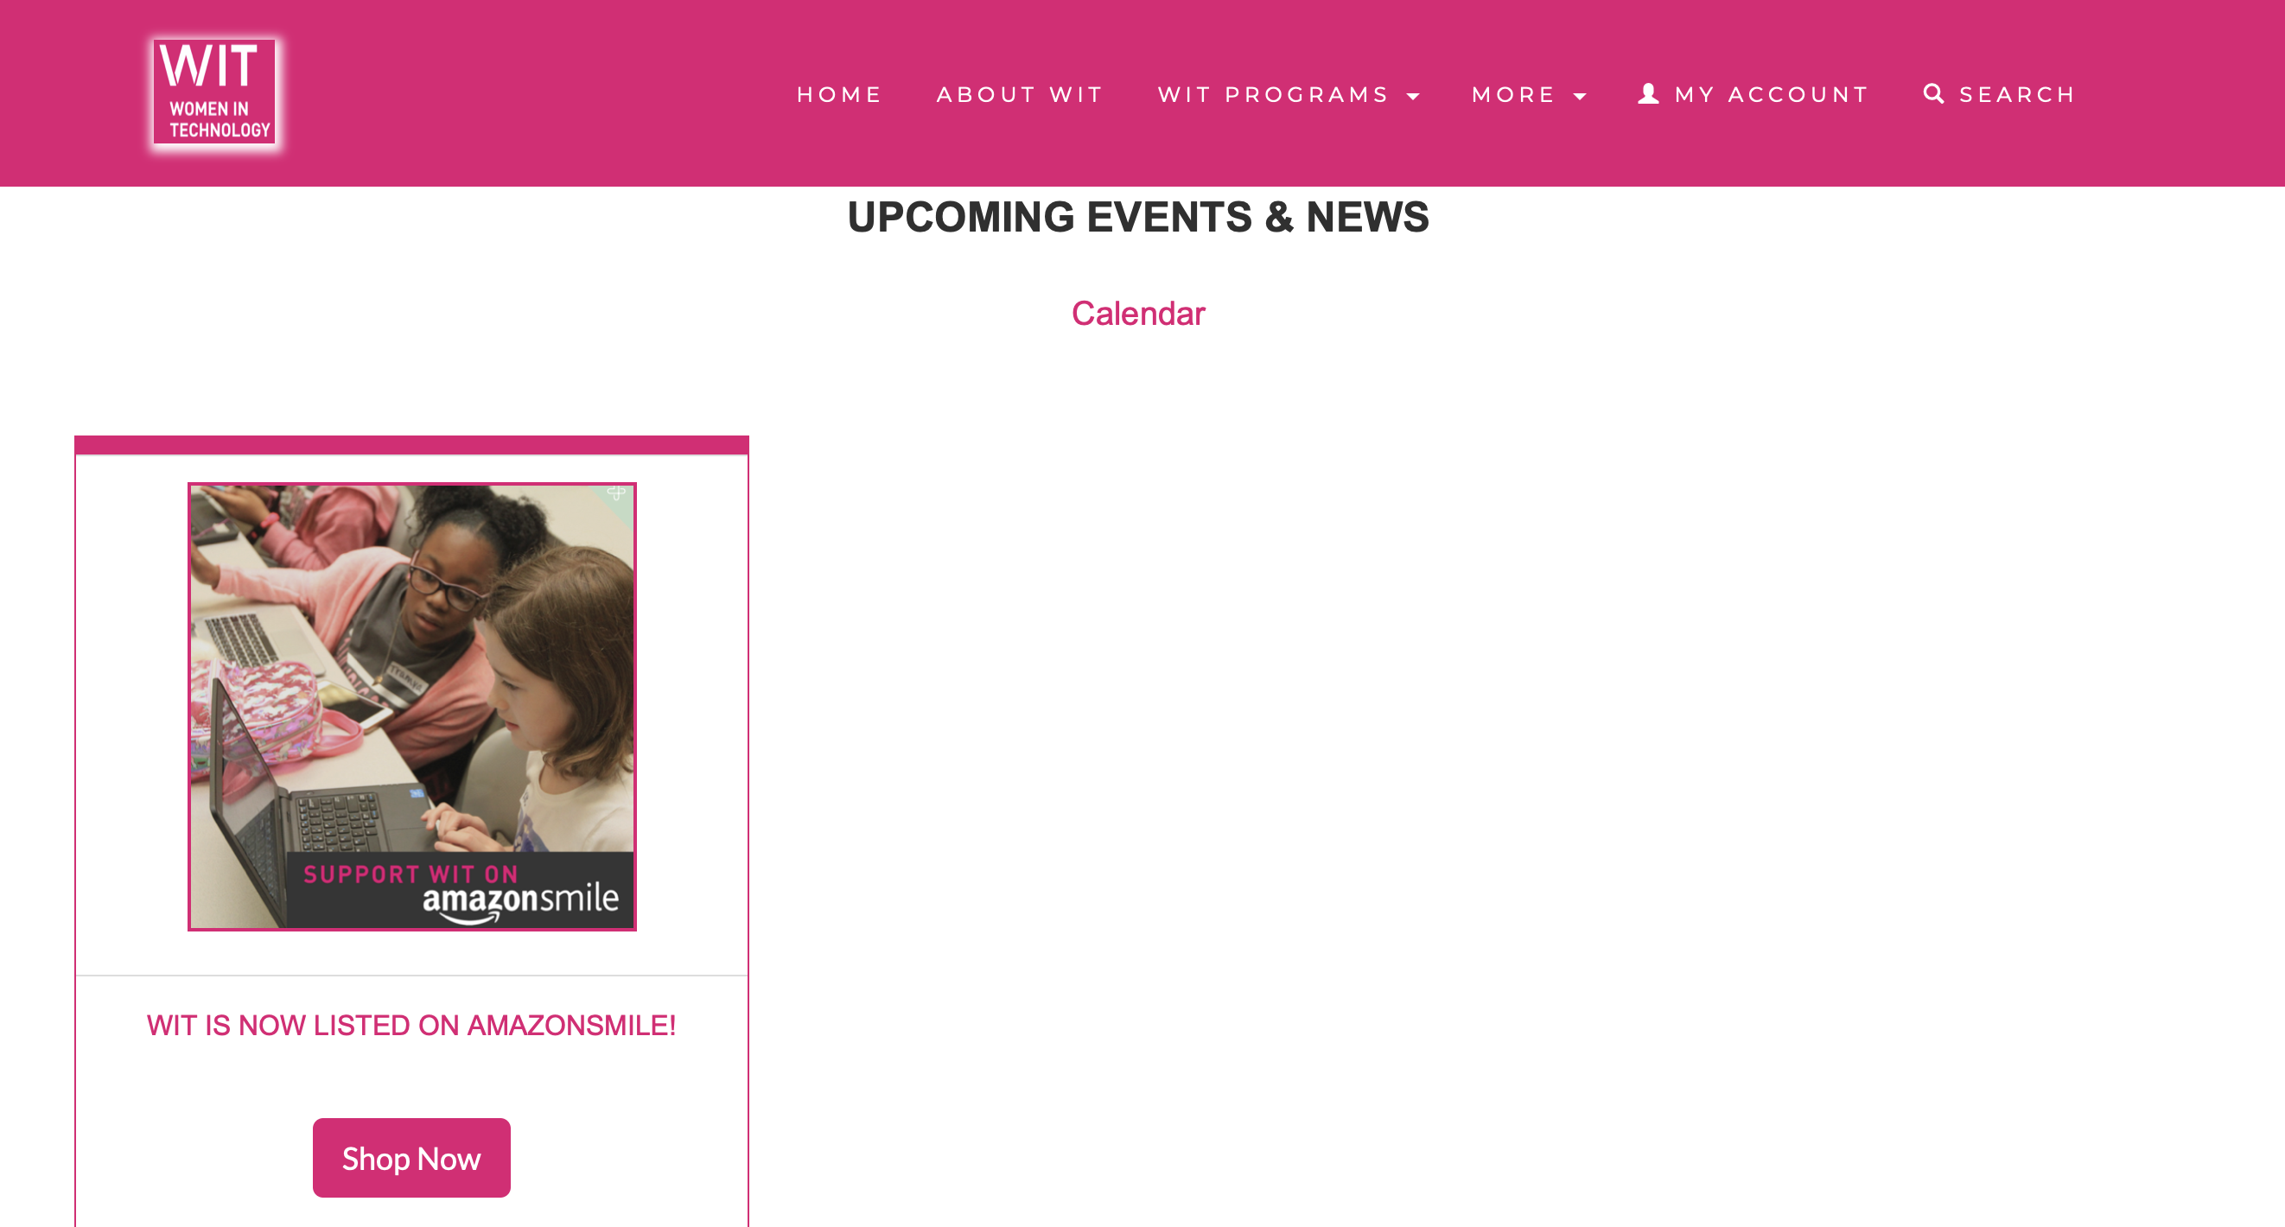
Donate

Slide 44
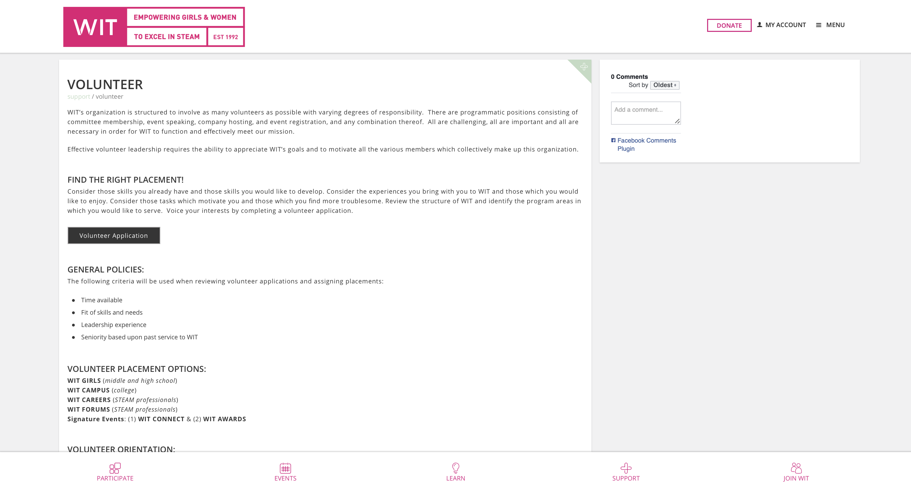
Volunteer Original

Slide 45
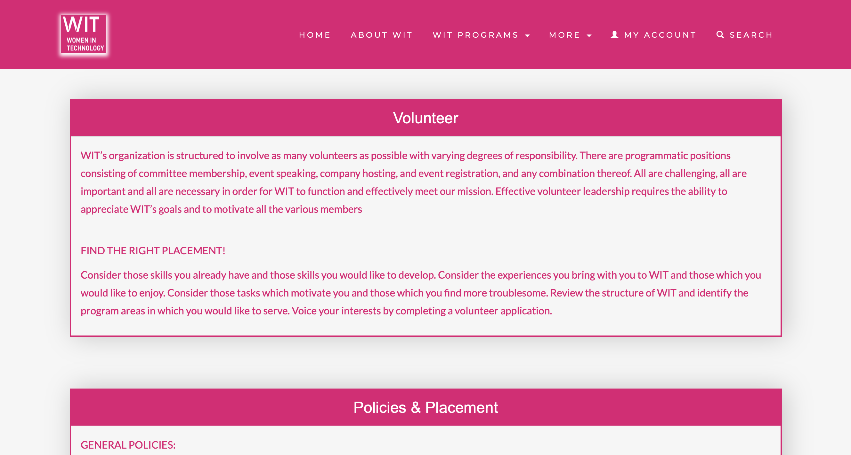
Volunteer

Slide 46
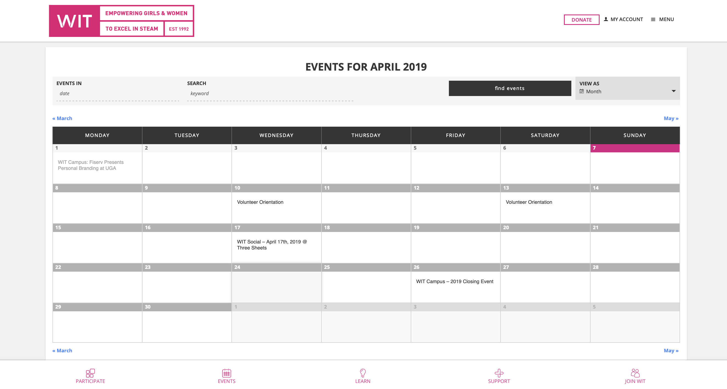
Calendar Original

Slide 47
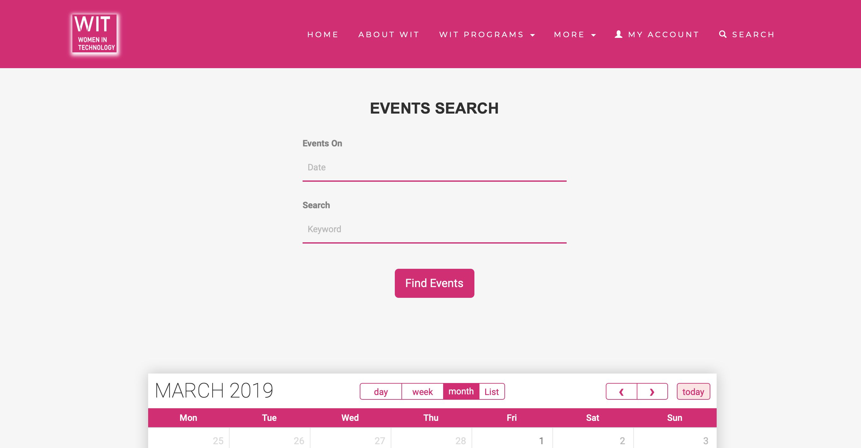
Calendar

Slide 48
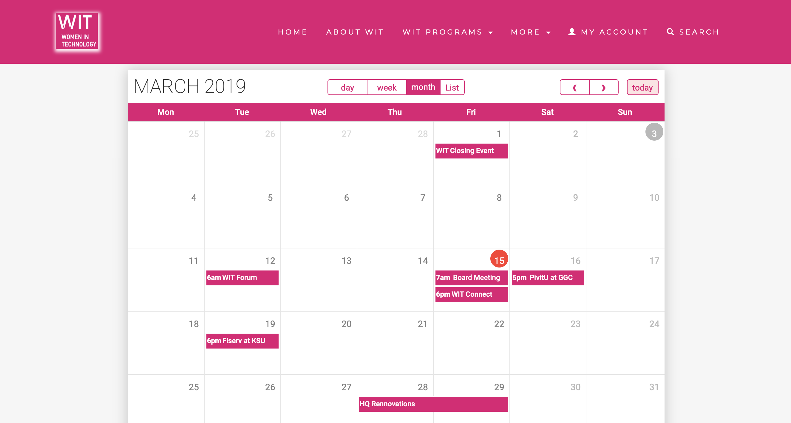
Calendar

Slide 49
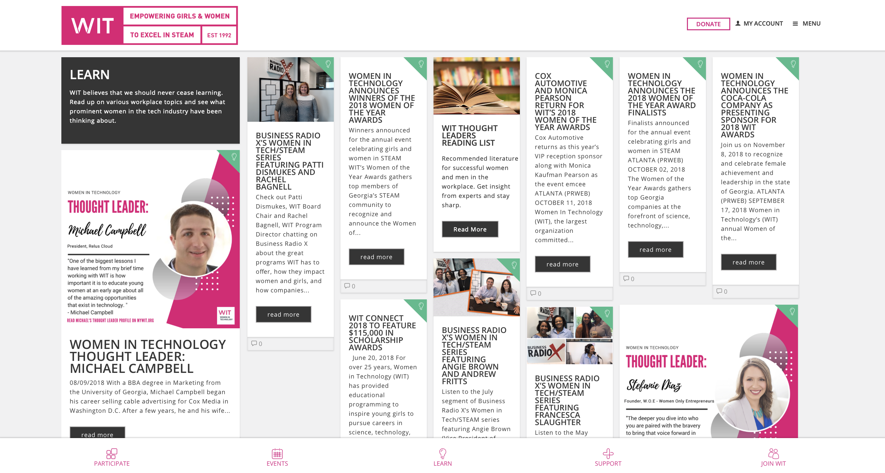
Learn Original

Slide 50
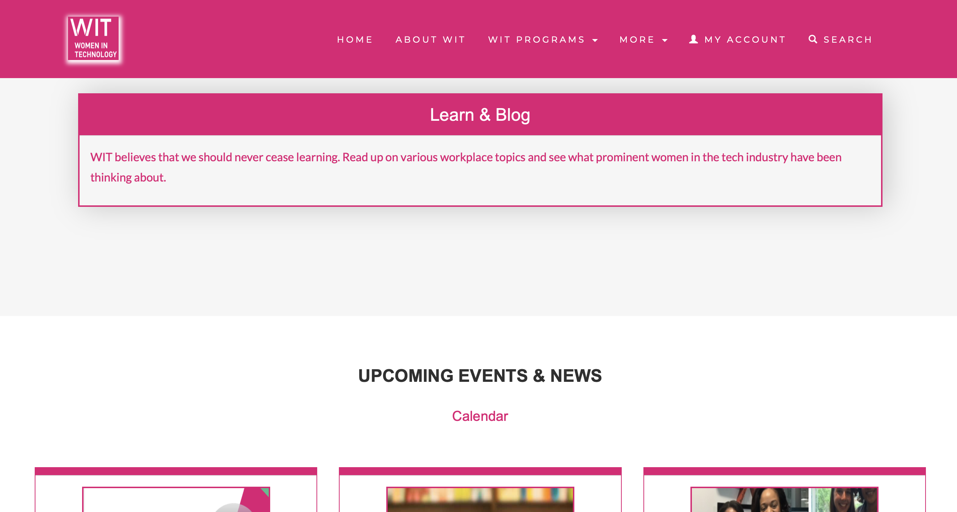
Learn

Slide 51
Thank You!

